Slide 1
Biomedical Image Captioning
Chris Morfopoulos

Slide 2
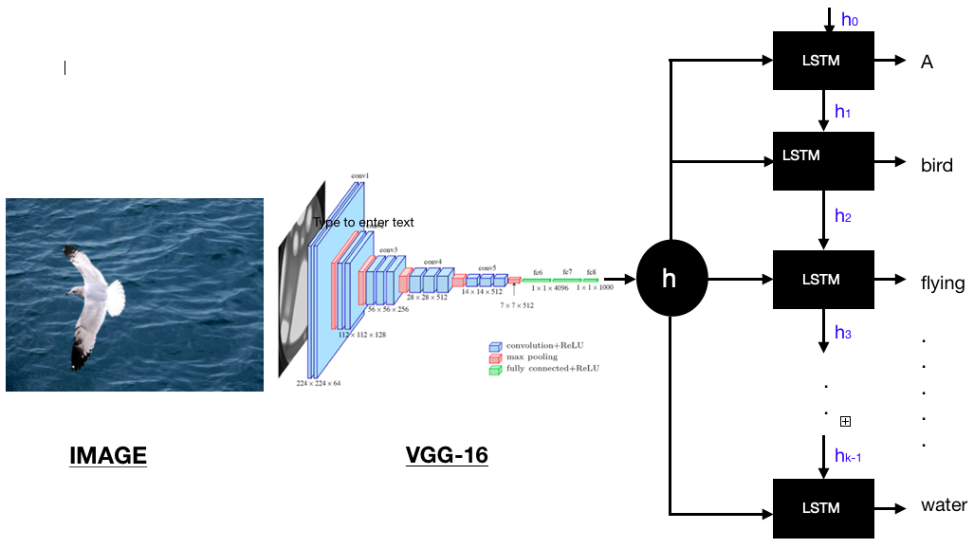
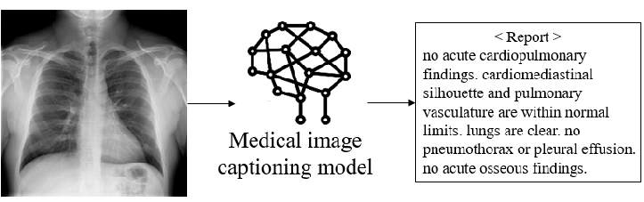
What is in general Image Captioning and why is important for medical use?
Illustrative Figure of Image captioning Model
Essentially, we can describe the image captioning deep learning models, as the process where the input is pixels of images, and the output is a brief generated caption describing the image.
The image captioning models can be adapted for biomedical use, where the inputs are x-rays images, and the captions describing the condition of patients.
In this way, an image captioning model can be trained on x-ray images, so it can generate a brief description of patients , helping the medical staff with their daily workload. At end of the day, it can be integrated as significant medical tool in many medical institutions.
Illustrative Figure of Medical Image captioning Model

Slide 3
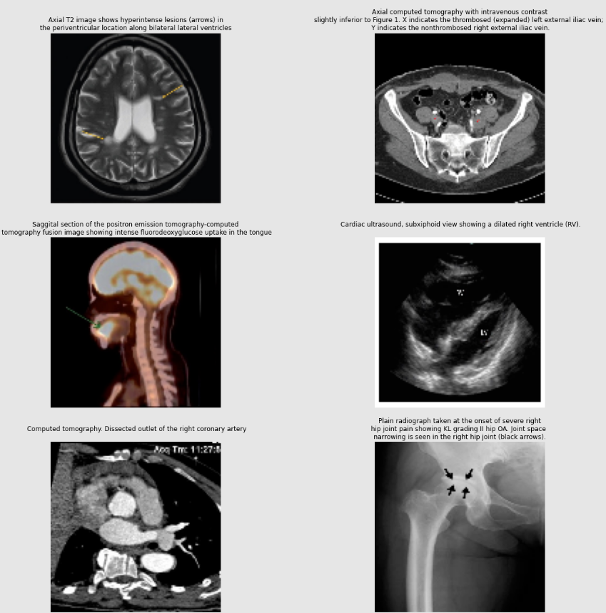
Roco Dataset
Sample of Images of the ROCO Dataset with their respective captions
The main training dataset that was utilized for our image captioning task is called ROCO dataset, which stands for Radiology Objects in Context.
The dataset contains over 81.000 images from several medical sections such as Computer Tomography (CT), X-rays, Magnetic Resonance (MRI), Angiography, Mammography and many more.

Slide 4
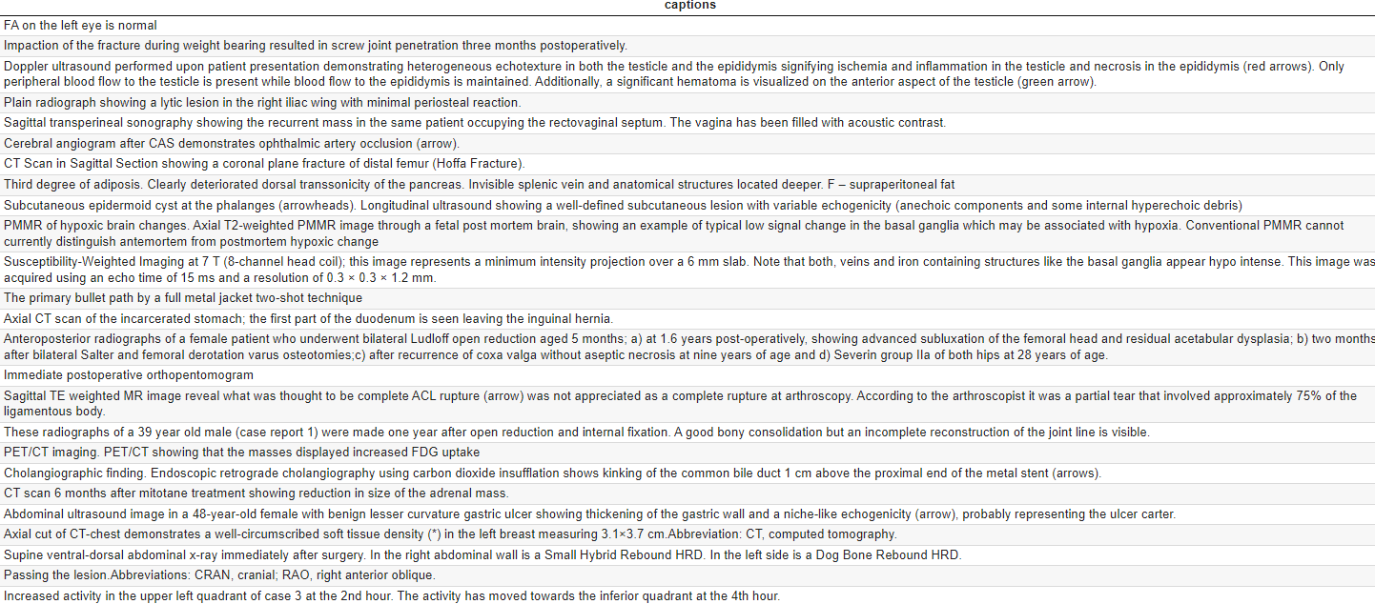
Preprocessing the Roco Dataset
Due to the nature of image captioning, the severe medical terminology and the structure of our medical captions, we applied limited data preprocessing actions.
An important assumption and data preprocessing action in order to remove noise from the captions was to remove redundant values, which lied inside of the parenthesis.
Other necessary actions was to remove punctuations, convert all strings to lowercase. Unfortunately, we can remove the stopwords.
Sample of captions from the ROCO dataset

Slide 5
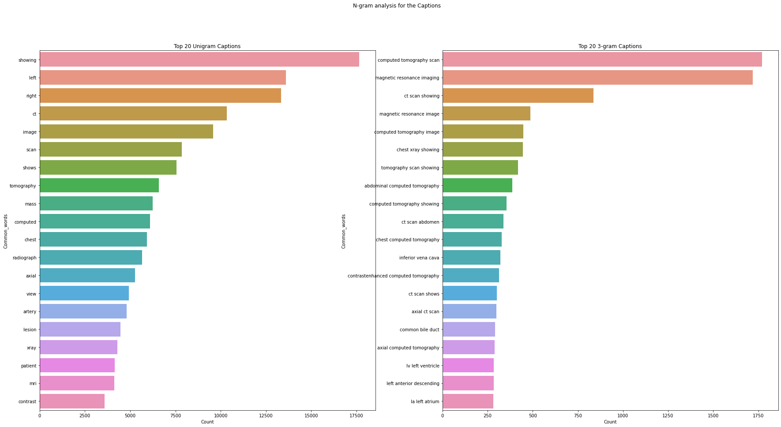
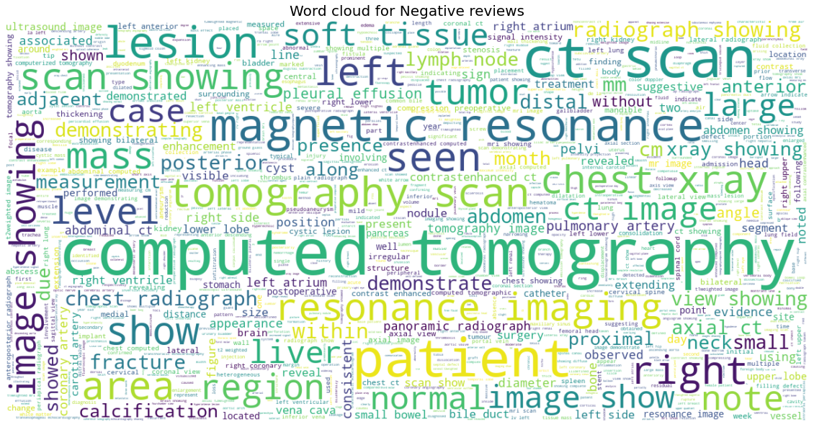
Visualizing the Roco Dataset
In order to visualize the captions of the ROCO dataset, we implemented a Word Cloud (removing all stopwords) and a visualization with top-20 words/terms in a unigram/3-gram.
Figure of top-20 words in unigram and 3-gram
Figure of a Word Cloud

Slide 6
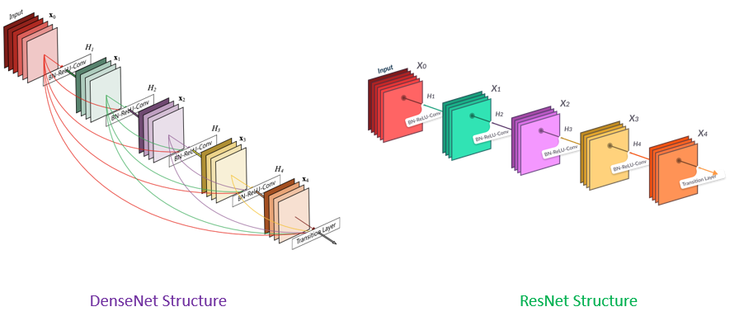
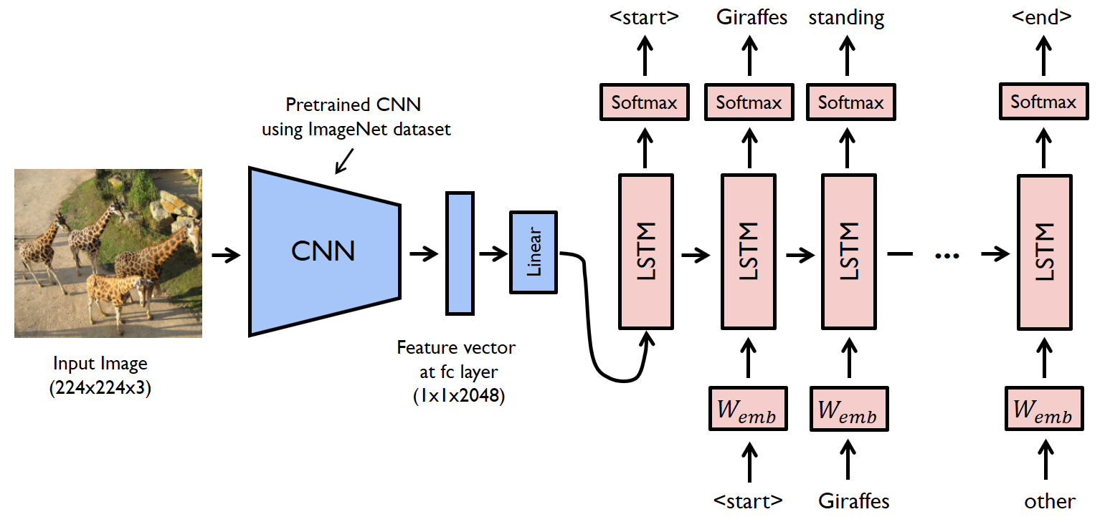
Architectures in Image Captioning
DenseNet architecture in contrast to the ResNet architecture
The first approach and the more conventional way to perform image captioning is with CNNs and LSTMs.
The key points in the architecture are to extract the features of an image from a pretrained CNN , create word embeddings with a tokenizer and finally conctatenate the image embeddings with the word embeddings to pass them to LSTM to generate the next word.
In our case, we implemented the DenseNet as a pretrained CNN along with the LSTM. The DenseNet architecture is similar to ResNet but with small differences in the residual connections. Therefore, the feature vector in our case has size of 1920.
The architecture of the CNN + LSTM , at high level

Slide 7
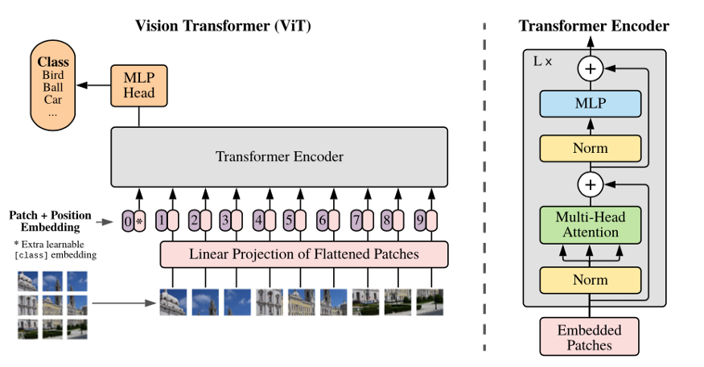
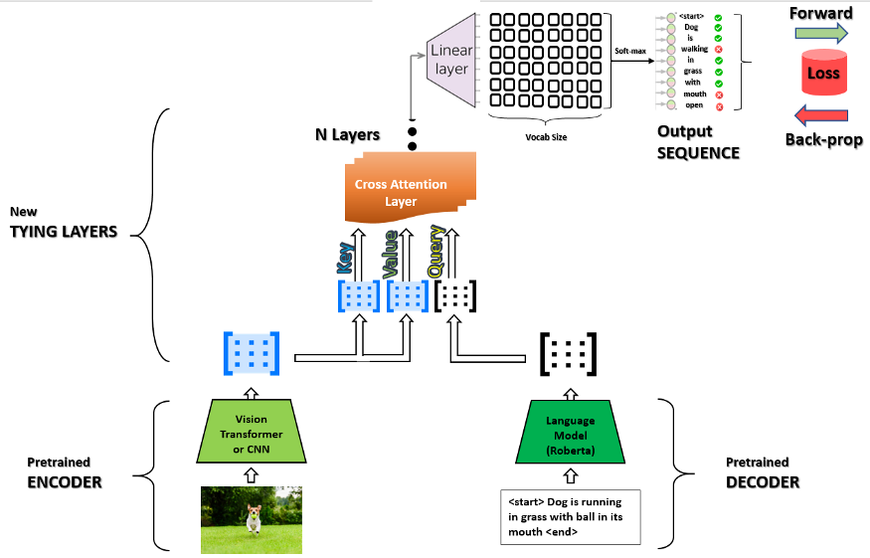
Architectures in Image Captioning
The contemporary approach and the more state of the art architecture to perform Image captioning is with the Encoder-Decoder architecture along with the attention mechanism, which was introduced in the “Attention is all you need” paper and belong to Transformers model family.
The Encoder-Decoder architecture, can be adapted in our case with a pretrained Language Model as a Decoder and a pretrained Vision Transformer as an Encoder.
The Vision Transfomer (ViT) consists of N-stacked Encoders and it uses attention instead of convolution for image recognition tasks.
The Decoders are also Transformer based Language Models such as Bert,GPT2 and MT5. The goal of Decoders is to be finetuned in our corpus of text in order to learn new words and generate brief captions. For Bert models,this can be established though Masked Language Modelling.
The connection between the Encoder and the Decoder is through the cross attention layer, where we map the Encoder ouput with the Decoder input. The decoder utilizes the Encoder’s keys and values.
Vision Transformer architecture
Vision Encoder Decoder Architecture

Slide 8
Models in the Biomedical Image Captioning
We implemented 5 experiments in total.
We invoked from Hugging face and finetuned several Language Models with our training corpus, though masked language modelling, apart from the GPT2 which it is a generative model.
For the DenseNet & LSTM model, we implemented the conventional architecture of image captioning.
For the rest of the models, we followed the Encoder – Decoder architecture, in which we utilized the ViT as an Encoder to extract the features and a finetuned Language model as a Decoder. As a final step, we combined the Encoder and the respective Decoder, to train end to end the VisionEncoderDecoder.
Dense Net & LSTM
ViT & Roberta
ViT & GPT2
ViT & BioBert
ViT & Greek Bert

Slide 9
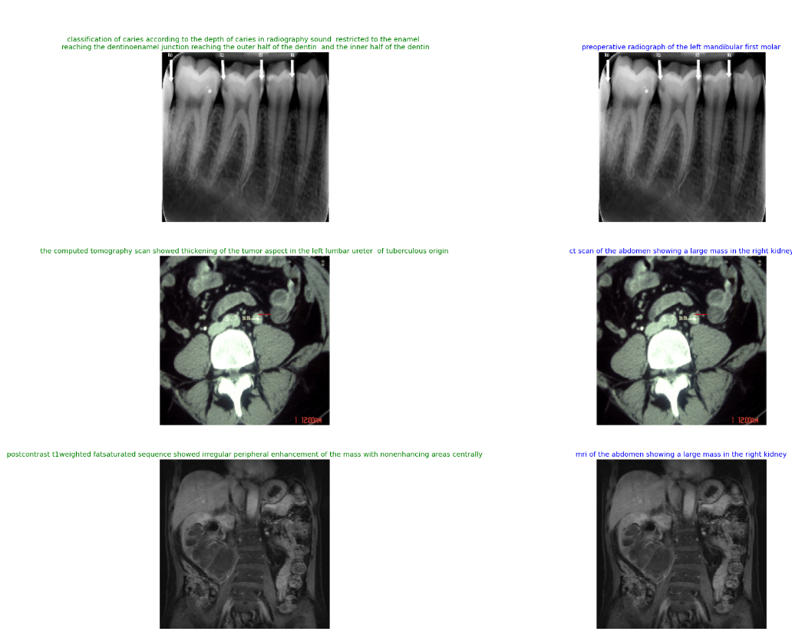
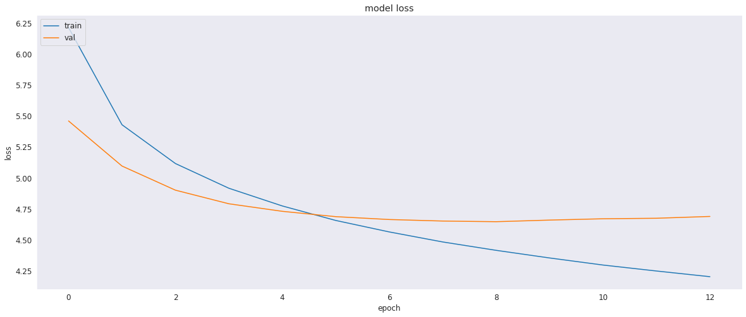
DenseNet & LSTM
We trained the DenseNet & LSTM model for 20 epochs with Early stopping. The model stopped at the 13th epoch due to Early Stopping, achieving the best validation loss at the 8th epoch.
The generated captions (blue) of the DenseNet & LSTM model along with the original captions (green)
The training and the validation loss of the DenseNet & LSTM

Slide 10
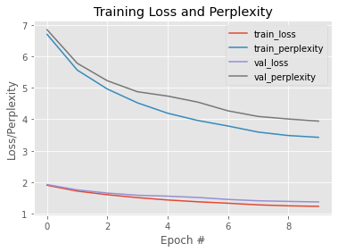
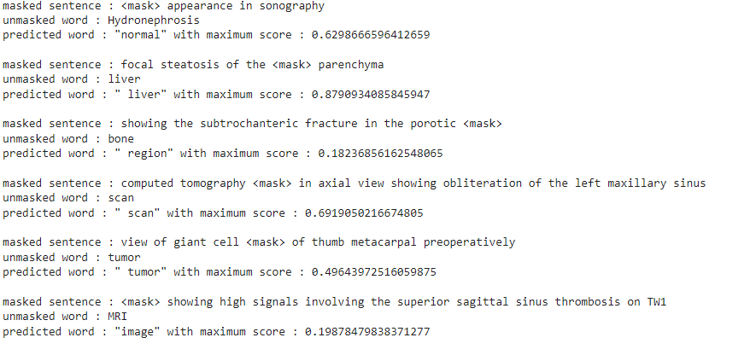
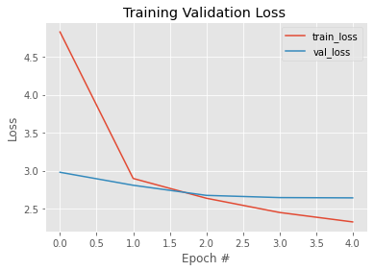
ViT & Roberta
The training process of the Decoder
We invoked the pretrained Roberta Language Model and trained/finetuned to our corpus for 10 epochs.
After the Decoder has been trained, we attached it with the Encoder (ViT) and trained the Vision Encoder Decoder model for 5 epochs.
The training process of the Encoder- Decoder
An evaluation in the trained decoder through MLM

Slide 11
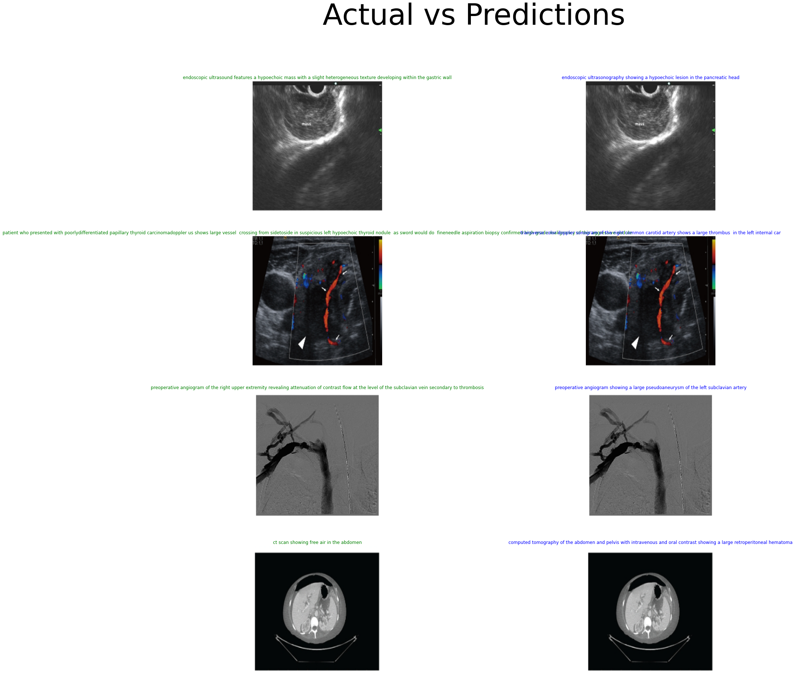
Generated Captions of ViT & Roberta
The generated captions (blue) of the ViT & Roberta model along with the original captions (green)

Slide 12
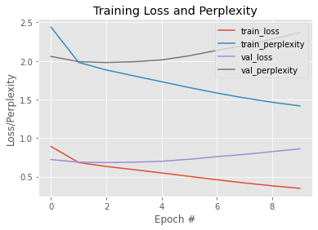
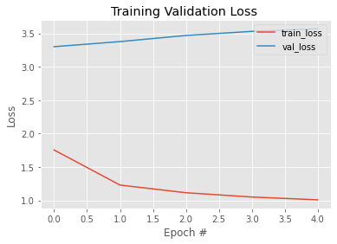
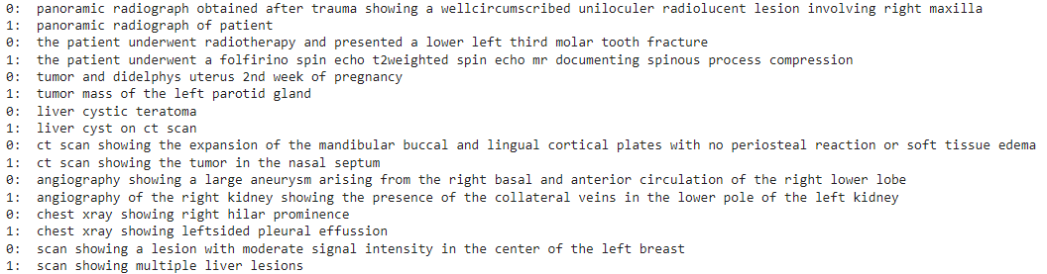
ViT & GPT2
The training process of the Decoder
We performed the same process but now for the GPT2 as decoder. As GPT2 is a generative Language Model we can not perform LML.
After the Decoder has been trained for 10 epochs to our corpus we can train end-to-end the Encoder-Decoder model for 5 epochs.
We should mention that the validation loss of the Vision Encoder Decoder has slightly increased, indicating that the model will have poor performance in the validation dataset.
The training process of the Encoder- Decoder
An evaluation in the trained decoder, to generate sentences through certain keywords

Slide 13
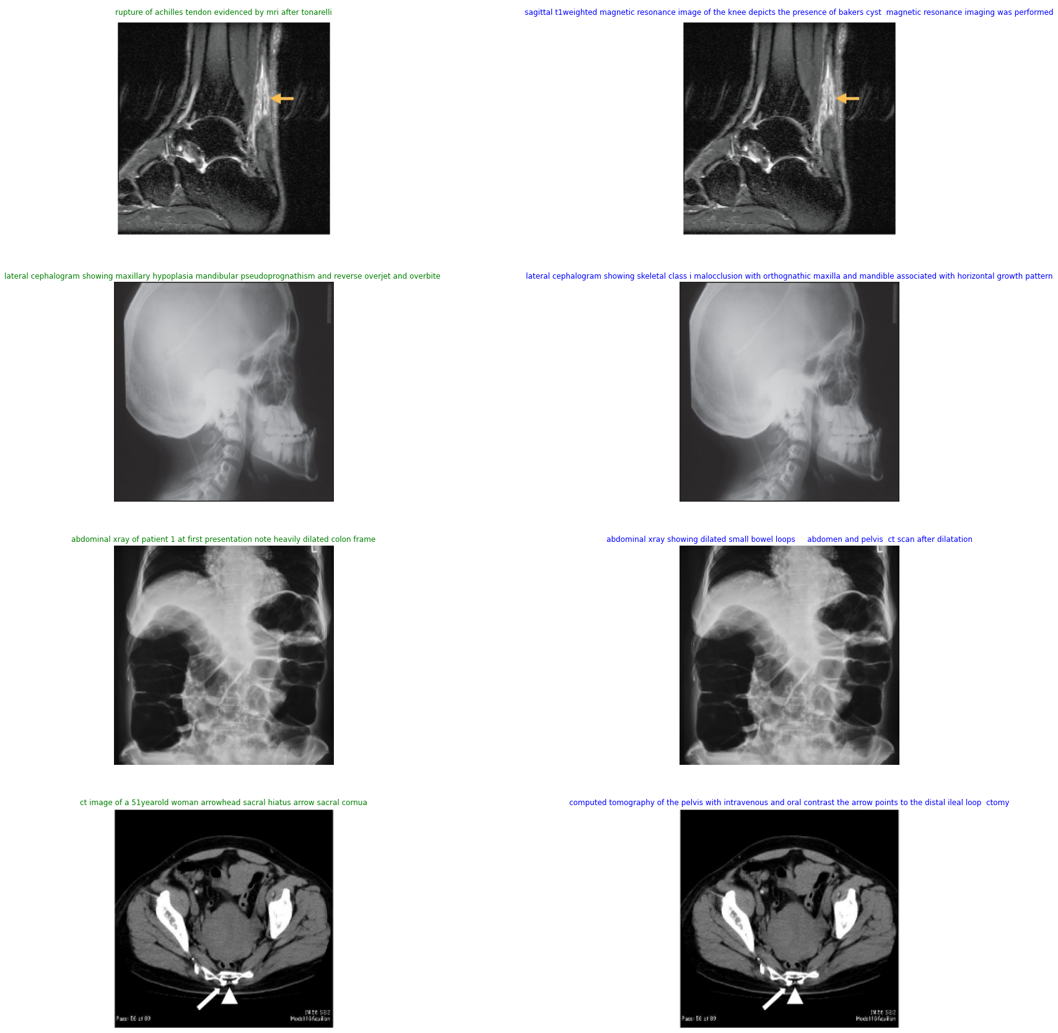
Generated Captions of ViT & GPT2
The generated captions (blue) of the ViT & GPT2 model along with the original captions (green)

Slide 14
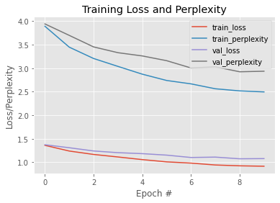
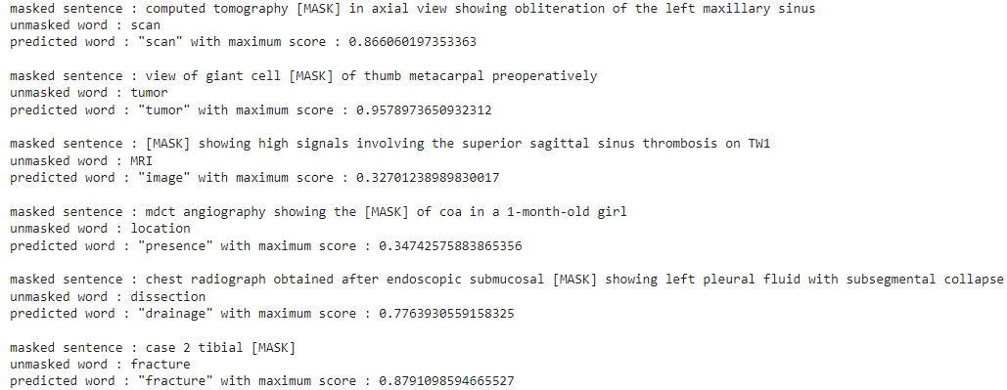
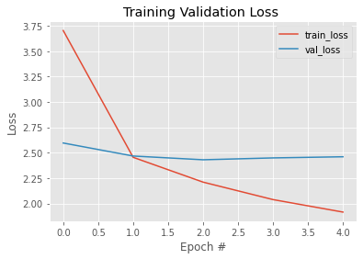
ViT & BioBert
The training process of the Decoder
The BioBert Language Model, is a pretrained model from Hugging Face (aka Bio Clinical Bert), which has the same architecture as BERT, and it is trained with large corpus of health corpus.
This will have as a result the BioBert to have a more enriched vocabulary in the medical terminology, thus expecting to have a better performance as a Decoder.
We followed the same step to train the Decoder for 10 epochs and the Vision Encoder-Decoder for 5 epochs.
An evaluation in the trained decoder through MLM
The training process of the Encoder- Decoder

Slide 15
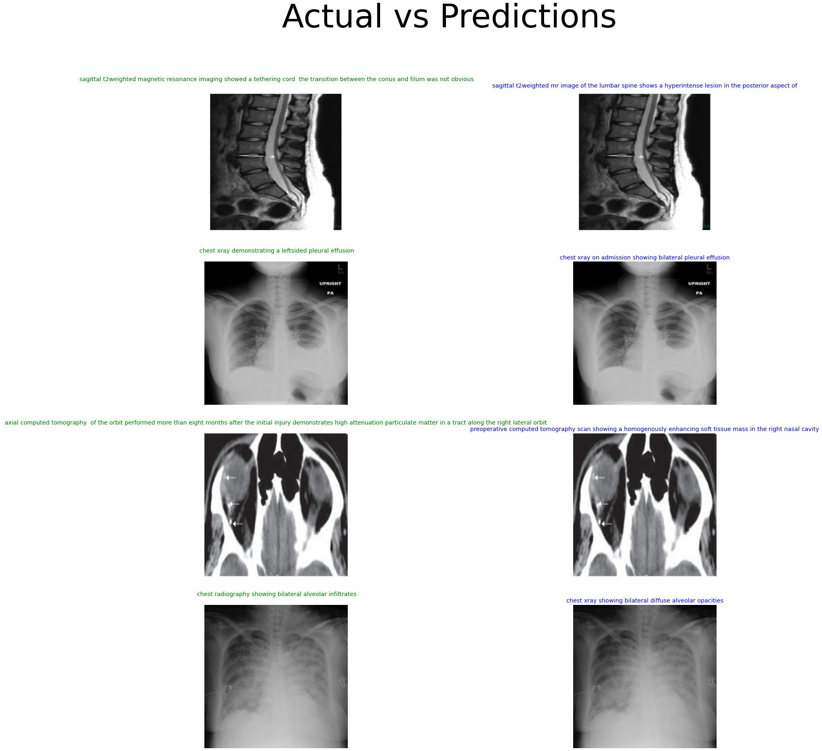
Generated Captions of ViT & BioBert
The generated captions (blue) of the ViT & Bio Bert model along with the original captions (green)

Slide 16
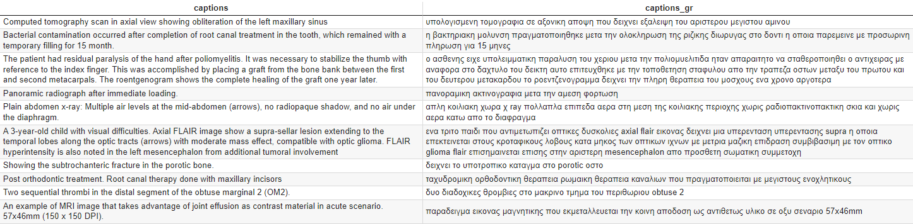
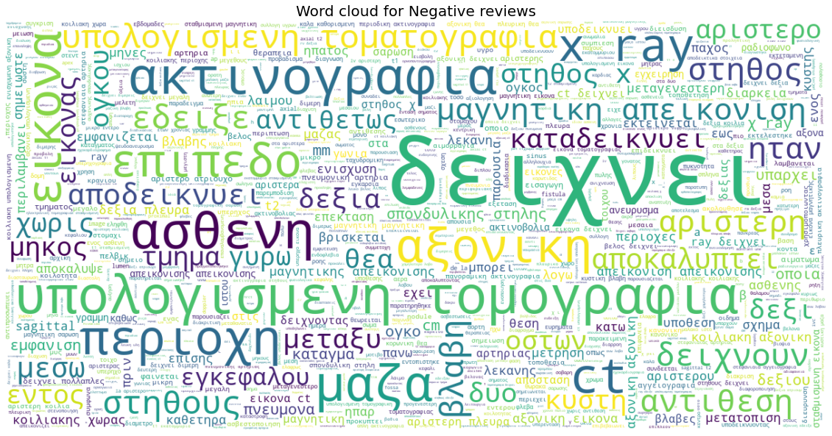
An experiment with ViT & Greek Bert
A sample of the Greek captions in contrast to the original captions
In order to translate the English captions of ROCO dataset to Greek, we invoked a pretrained translation model from Hugging face (Helsinki-NLP/opus-mt-en-grk).
Unfortunately, the transition from English to Greek led to same translation errors, mainly since the translation model was not train on the English-Greek medical terminology.
We should mention that an additional necessary preprocessing action for the translated Greek captions is to remove the accents.
A Word Cloud of the Greek Captions

Slide 17
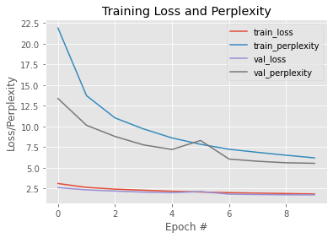
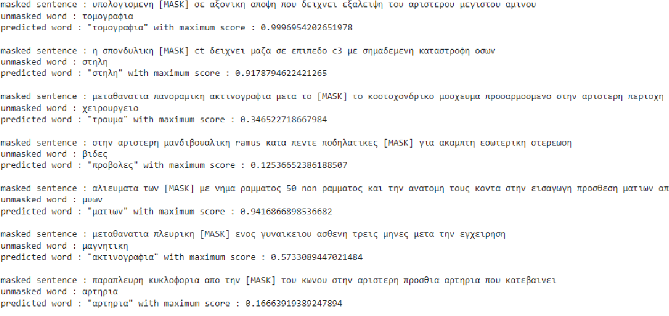
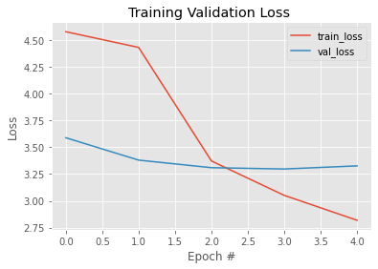
An experiment with ViT & Greek Bert
We invoked the pretrained Greek version of Bert, and finetuned to our translated Greek captions. We trained the Decoder for 10 epochs, and we masked certain captions ,to check the performance of the Decoder.
As a last step, we train the Encoder (ViT) with the Decoder as a Vision Encoder Decoder model for 10 epochs. From the figure below we can notice the validation loss was slightly decreased.
Although the assumptions that we made as the Greek translated captions had an integrated error, the overall performance of the model can be considered as a good estimation.
The training process of the Decoder
The training process of the Encoder- Decoder
An evaluation in the trained decoder

Slide 18
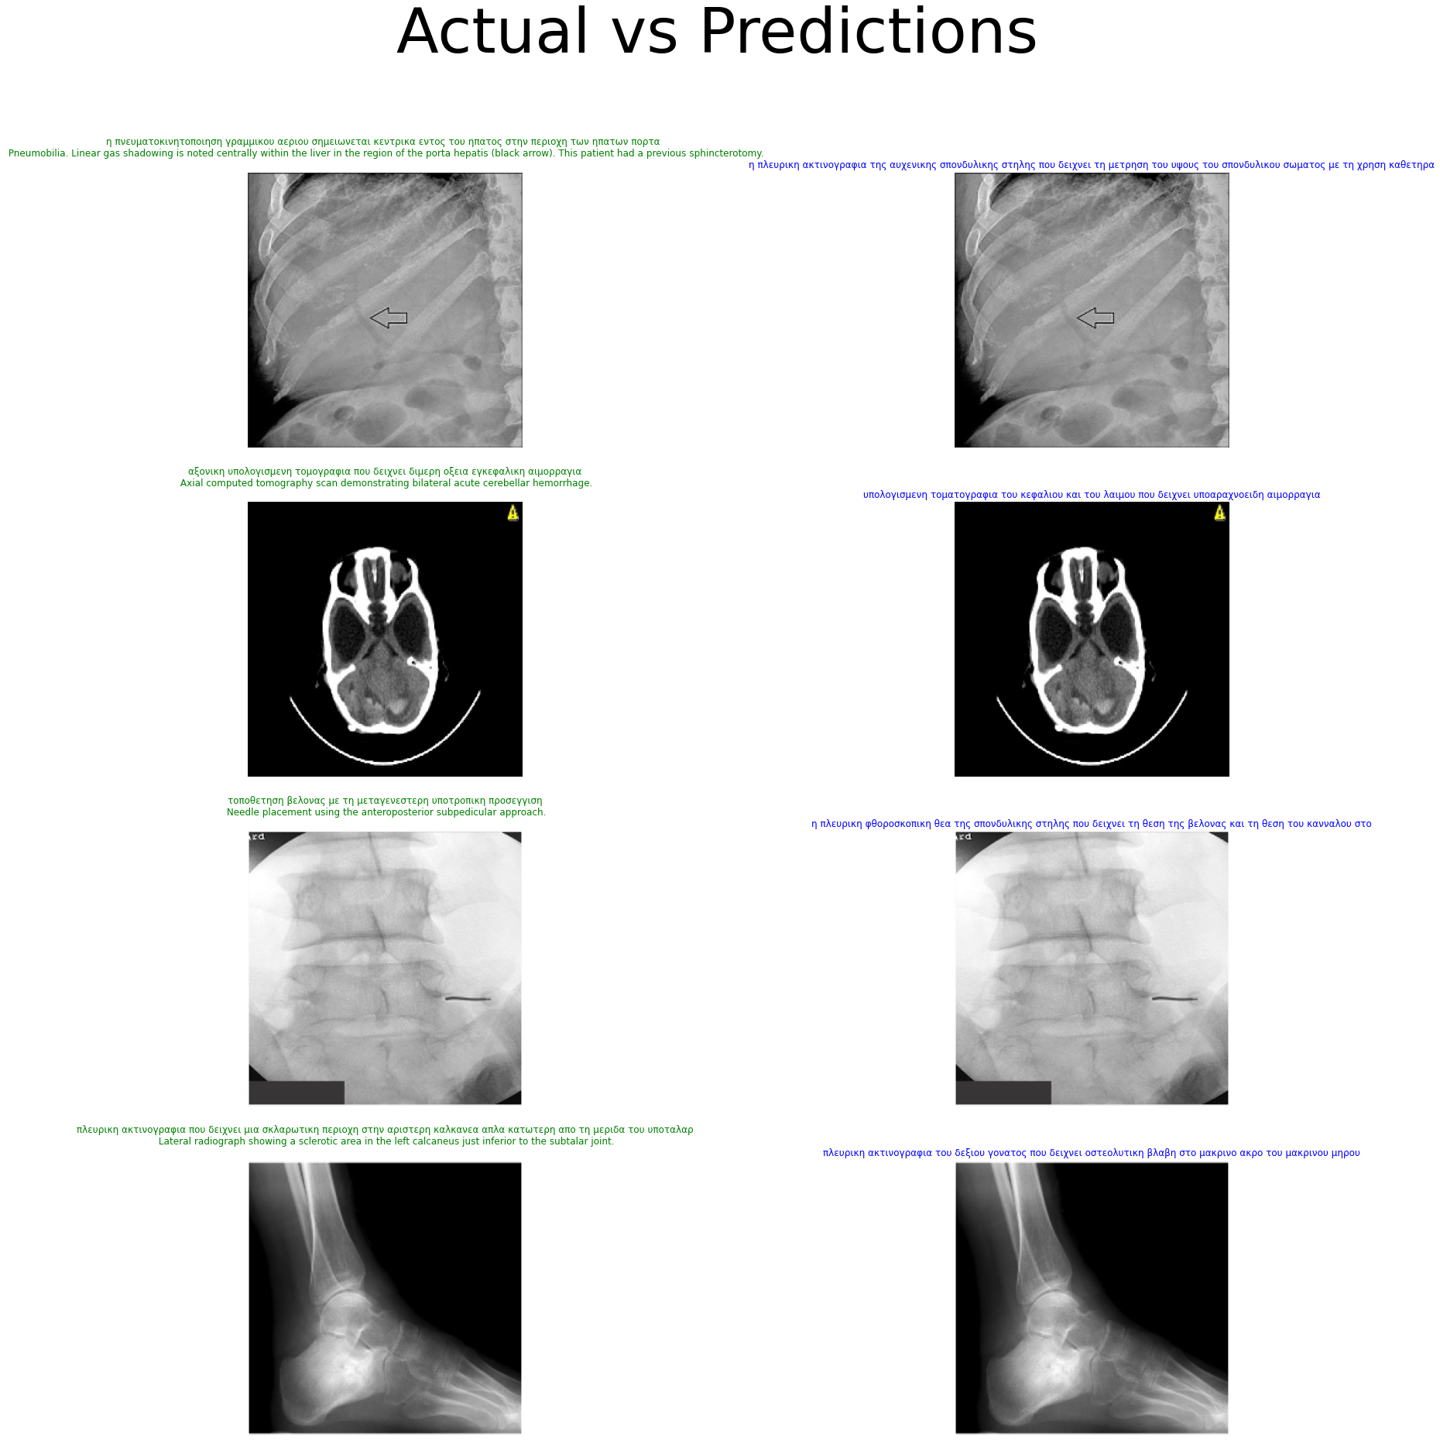
An experiment with ViT & Greek Bert
The generated captions (blue) of the ViT & Greek Bert model along with the original captions (green)

Slide 19
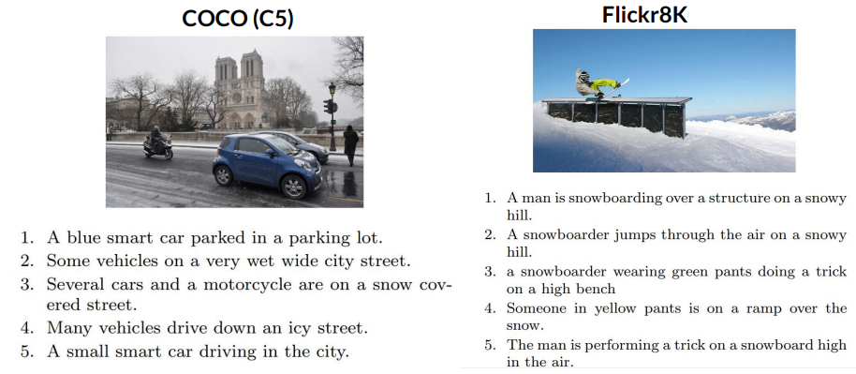
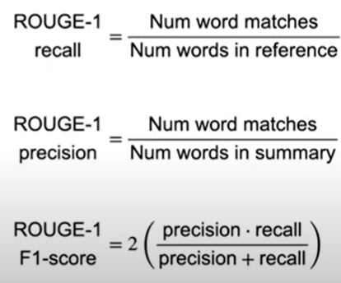
Evaluation Metrics
A sample of images and captions from the COCO and the FLICKR8K datasets
As we mentioned the captions in the ROCO dataset have not only a lot of “noise”, but also a hard medical terminology which is hard to interpret in the generated captions.
As we can notice the captions from the example of the Flickr8K dataset, the original captions can differ but eventually all describe the same task. Therefore in generated medical captions but in generated text in general, is challenging to evaluate the model.
Nevertheless, we utilized the RougeN evaluation metrics, which compare the n-grams of the generated summary to the n-grams of the original summary. As the name implies, the Rouge1 metric focuses only to unigrams. In this way, in order to evaluate our models , we computed the Rouge1 Precision and Recall , as well as their harmonic mean the Rouge1 F1.
Definitions/Formulas of the Rouge 1 metrics

Slide 20
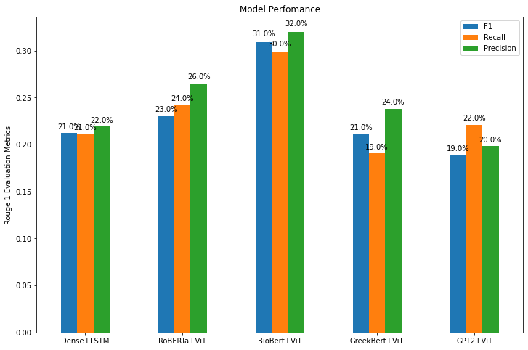
Overall Performance of the Models
In order to evaluate our trained models and select our best model, we take a subset of the validation dataset and we calculated the Rouge1 evaluation metrics.
As expected, the ViT & Bio Bert marked the best Rouge F1 score with 31%. As we can see from the graph, the second best model is the ViT & Roberta with 23%, which is significantly less than the ViT & BioBert. Additionally, the Greek Bert & Vit marked the same score in Rouge1 F1 score as the conventional DenseNet & LSTM.
Lastly, the ViT & GPT2 had the lowest performance in contrast to other models, reaching 19% in Rouge1 F1 score.
A visualization of the Rouge 1 metrics of the respective models

Slide 21
Summary - Key points
In the series of our experiments , we showed how the encoder-decoder models and mainly the ViT&BioBert outperform the conventional models of Image Captioning such as the DenseNet& LSTM model. This is mainly due to the limitations of the RNN and LSTM.
We mentioned that is very challenging not only to evaluate the generated captions, but also to interpret the biomedical generated captions in contrast to the original captions.
Due to the nature of medical Image captioning with its terminology, we believe that the ROCO captions need further to process to eliminate the noise and make the captions more compact and brief, so the image captioning models would benefit the end-to-end process.

Slide 22
Thank you!
Any questions?

